Slide 1
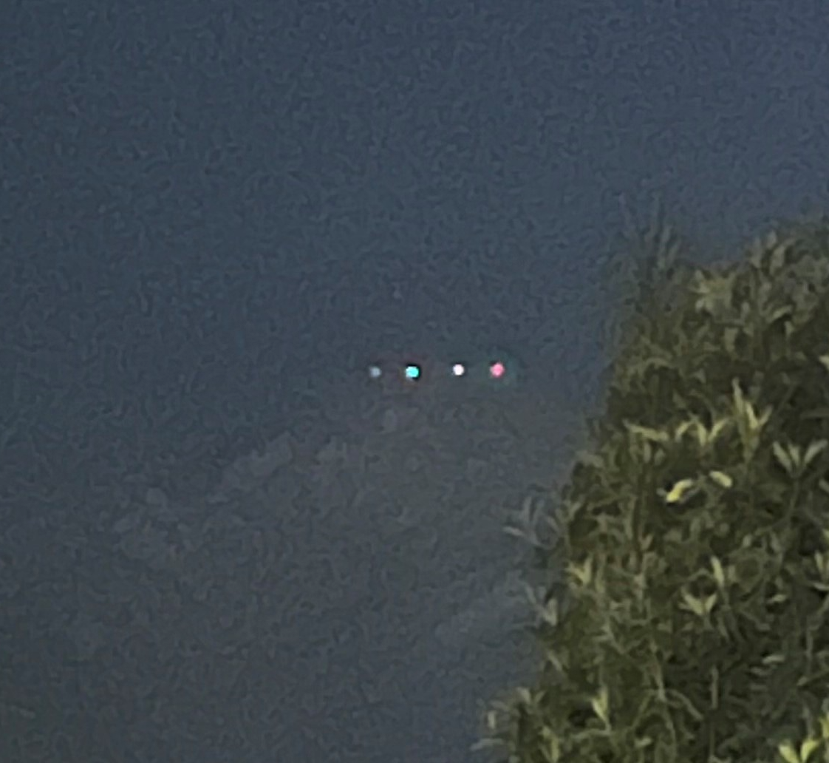
National UFO Reporting Center Webscrape
Colin Sandidge

Slide 2



Agenda
Introduction
Challenges
Most Reported Type of Craft
Highest UFO Counts by State
Highest UFO Counts by Date
Total Sightings by Hour
Total Sightings by Season
Mean Duration by Year
Hotspots!

Slide 3
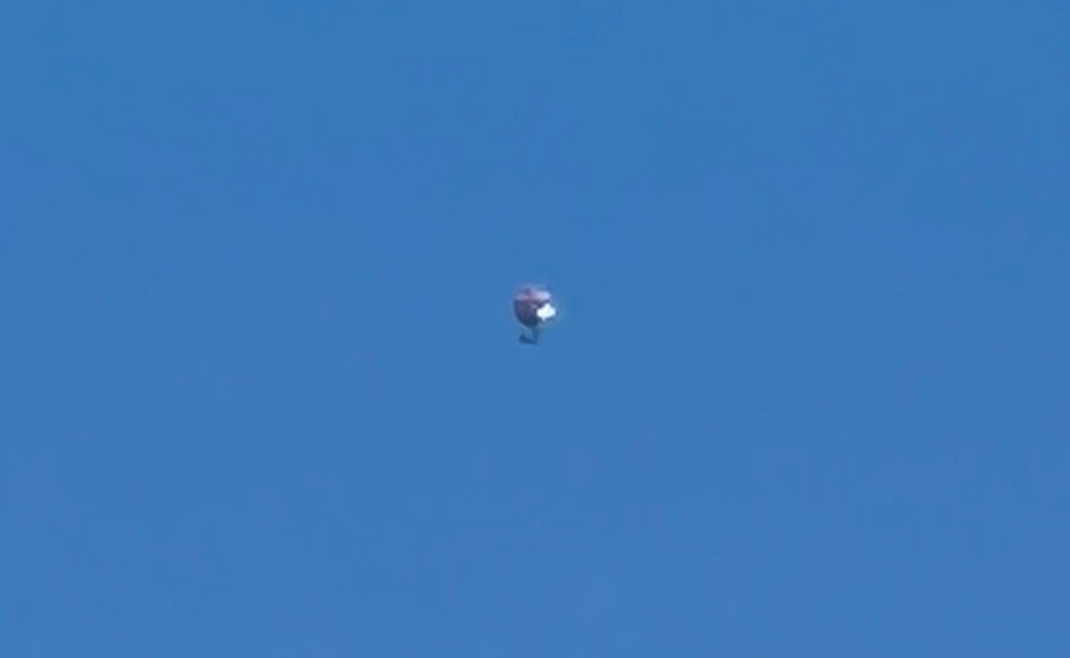
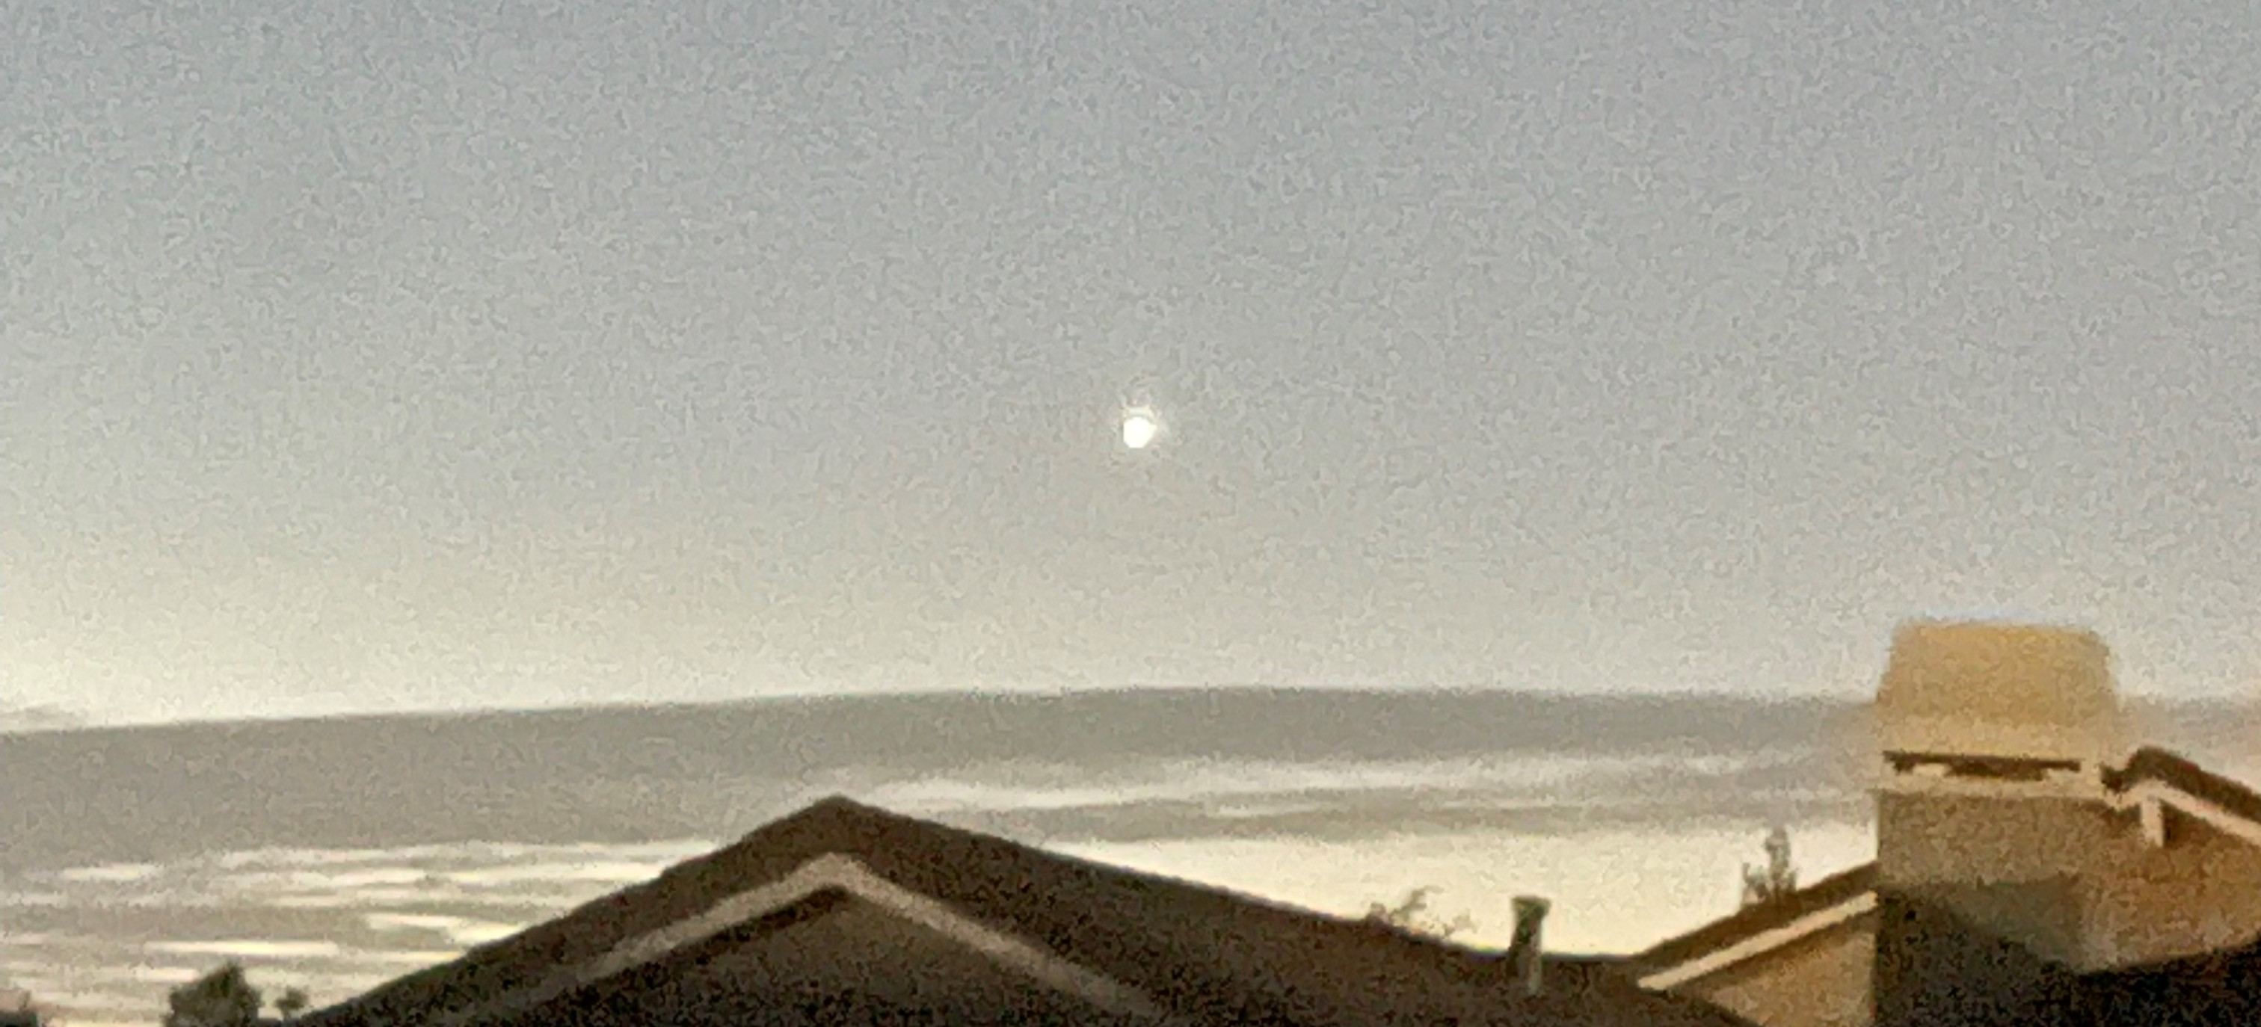
Introduction
All data taken from nuforc.org
Self-reported UFO sightings
A lot of variability in the data

Slide 4

Challenges

Slide 5
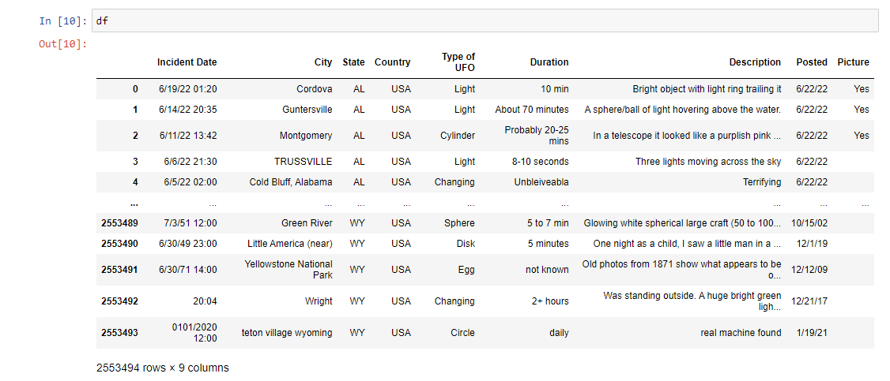
Data Cleaning!

Slide 6
Most Reported Type of Craft

Slide 7
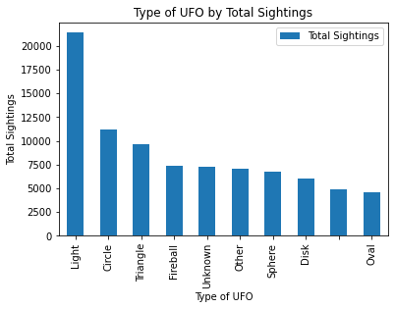
Top 10 Most Reported Type of Craft
‘Light’ is by far the most popular type of UFO witnessed
~5000 sightings left the ‘Type of UFO’ field completely blank

Slide 8
Highest UFO Counts by State

Slide 9
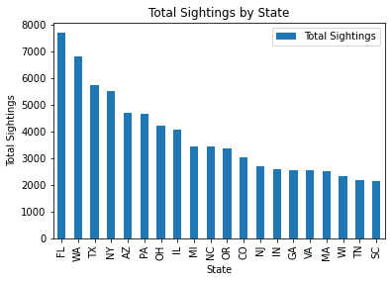
Top 20 States for UFO Activity
Florida was the most popular State for UFO activity
Tennessee was the 19th most popular State for UFO activity

Slide 10
Highest UFO Counts by Date

Slide 11
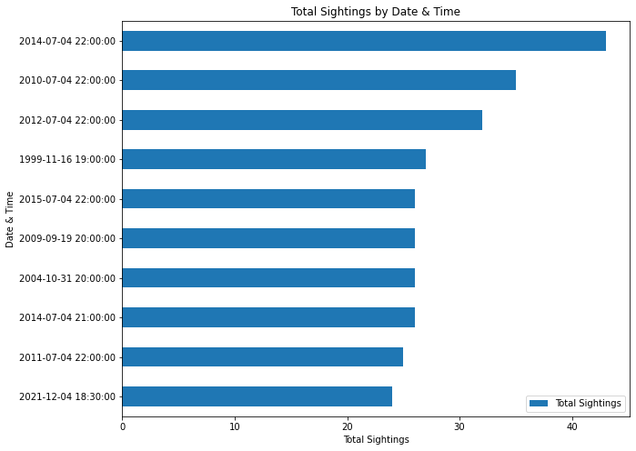
Top 10 Dates for UFO Activity
Interestingly, July 4th was the most popular date for UFO activity
July 4th is in the top 10 seven times
10:00 P.M. seems to be the most popular time to spot UFO activity on July 4th

Slide 12
Total Sightings by Hour

Slide 13
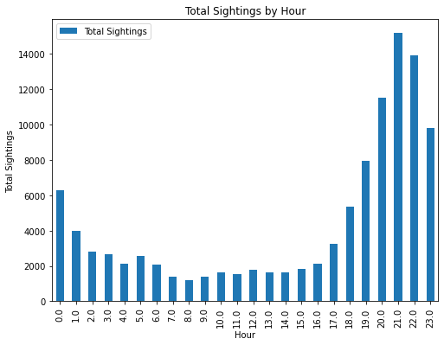
Total Sightings by Hour
Much more likely to see UFO activity at night than midday
9:00 and 10:00 P.M. are first and second most popular times to spot UFO activity, respectively

Slide 14
Total Sightings by Season

Slide 15
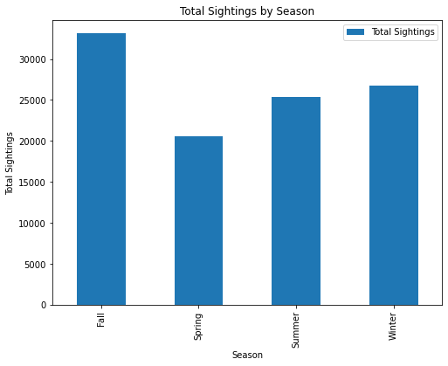
Breakdown of UFO Activity by Season
Fall is the most popular season for UFO activity

Slide 16
Total Sightings by Year

Slide 17
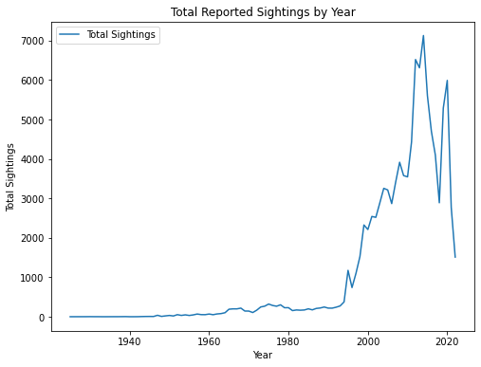
Total Sightings by Year
General trend of increased reporting as access to technology improves is to be expected.
Sudden dip in 2018 and 2021 may be worth exploring

Slide 18
Mean Duration by Year

Slide 19
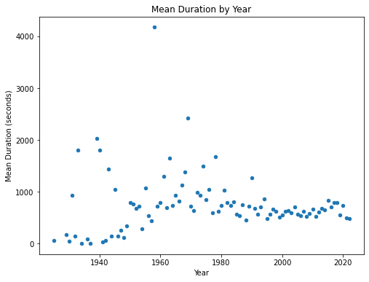
Mean Duration by Year
Mean duration per UFO sighting: ~15 minutes
Expected the mean to increase through the years with access to better ways to document activity but has stayed relatively consistent
Variability in data can be explained by documentation process

Slide 20
Hotspots!

Slide 21
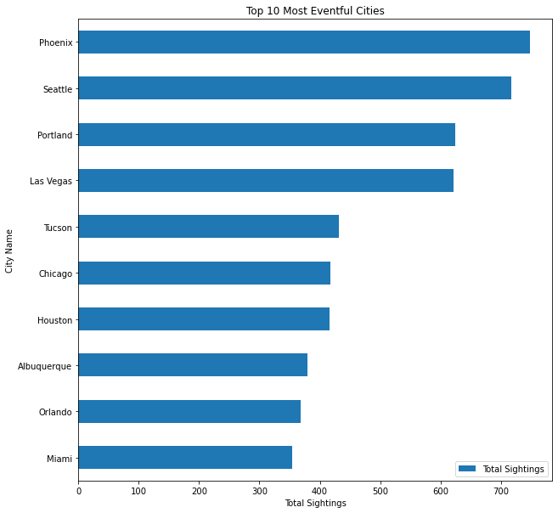
Top 10 UFO Activity Hotspots!
Phoenix is top city for UFO activity, followed closely by Seattle
Arizona and Florida are two most active States in the hotspot list

Slide 22
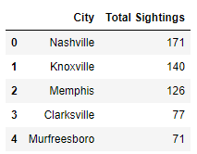
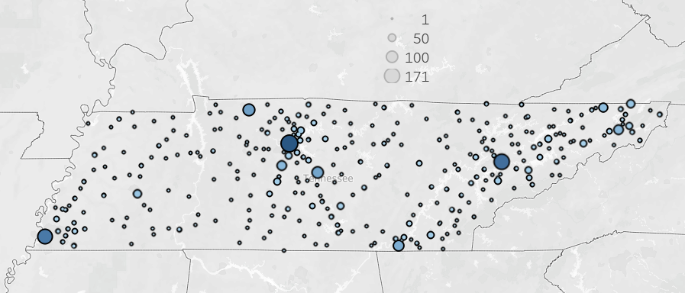
Tennessee Hotspots!

Slide 23
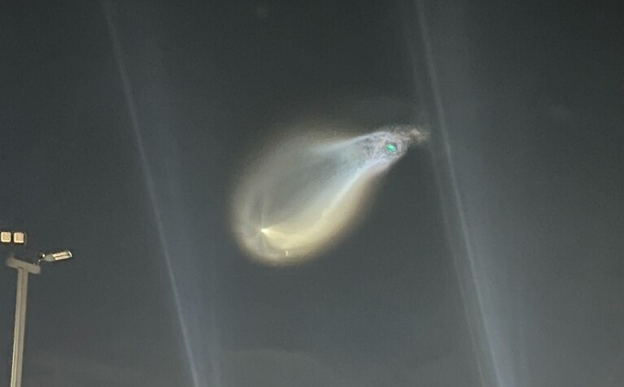
Summary
The data findings suggest an increased likelihood of seeing a UFO on July 4th from 9:00 - 10:00 pm EST in the urban areas and neighborhoods specified in this report.

Slide 24
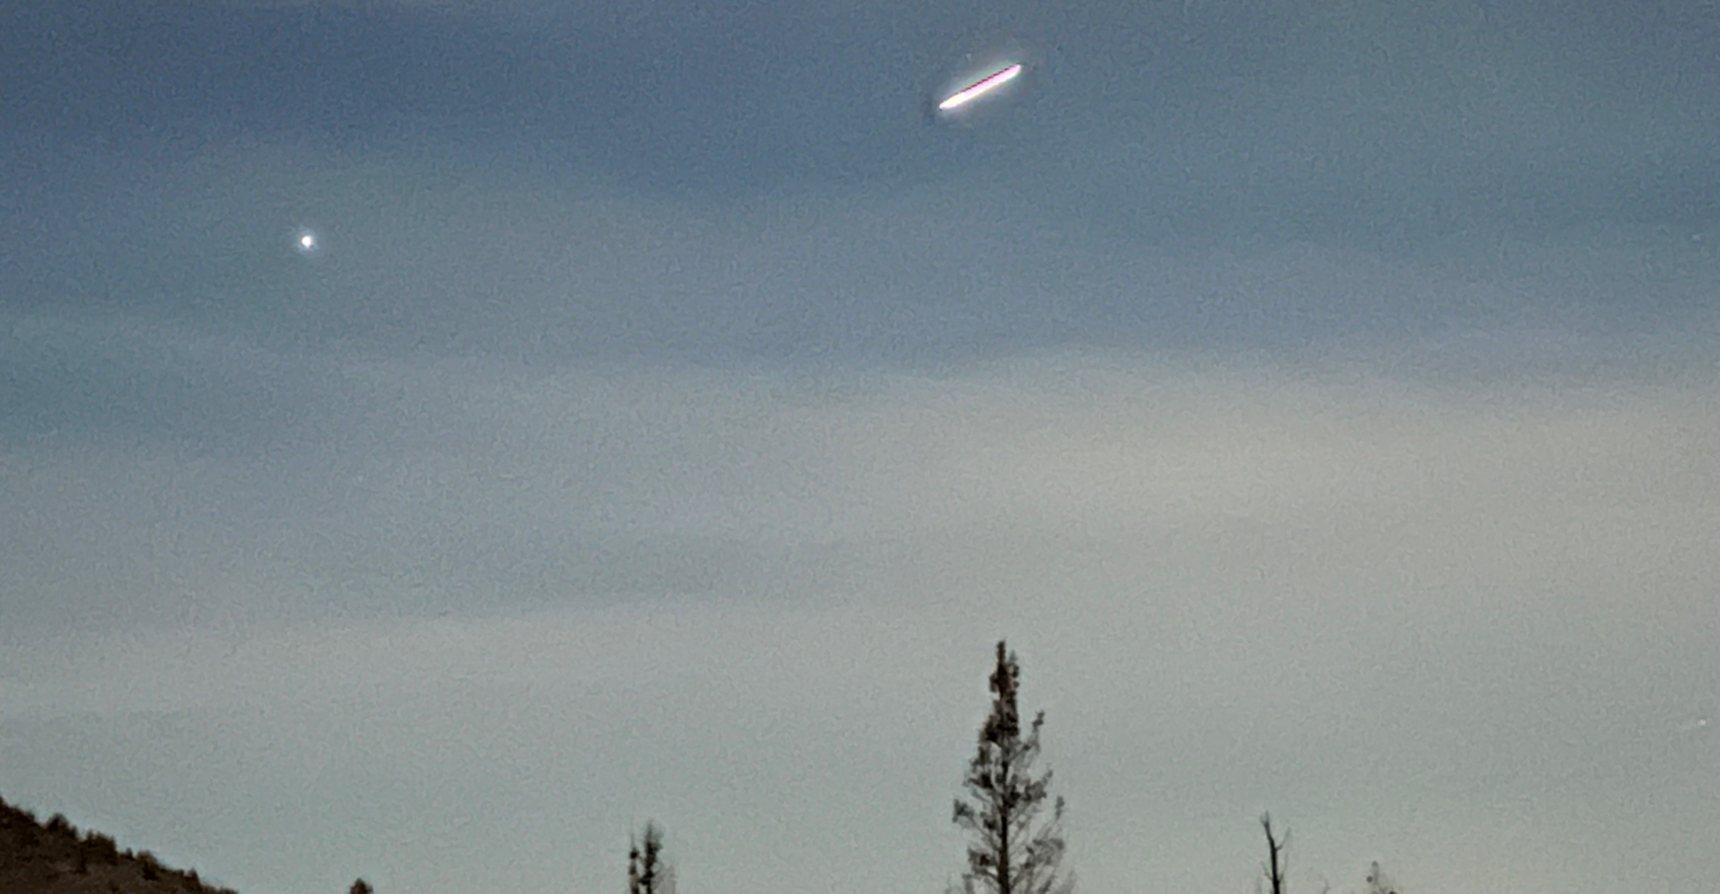
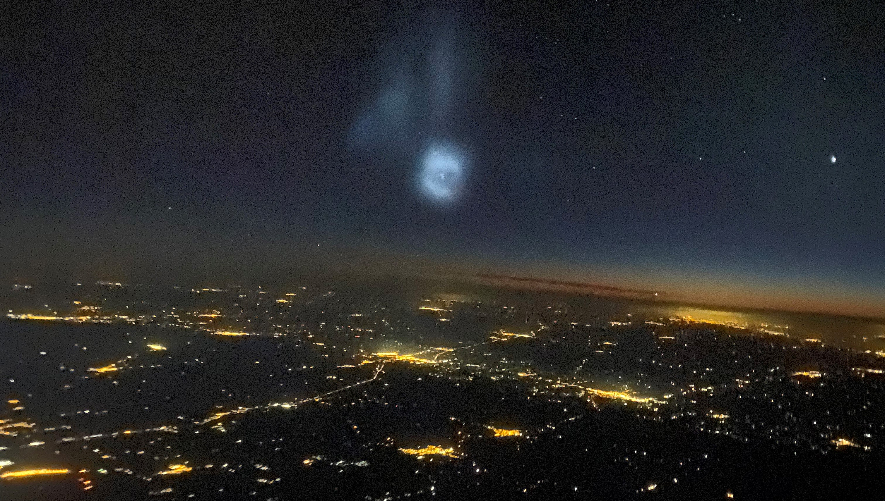
Thank You
Colin Sandidge
Colin.Sandidge@gmail.com
https://www.linkedin.com/in/colinsandidge/
https://github.com/ColinSandidge

